Slide 1

UTSPAN Hacks 2019
Team RJ Barrett’s Jersey

Slide 2
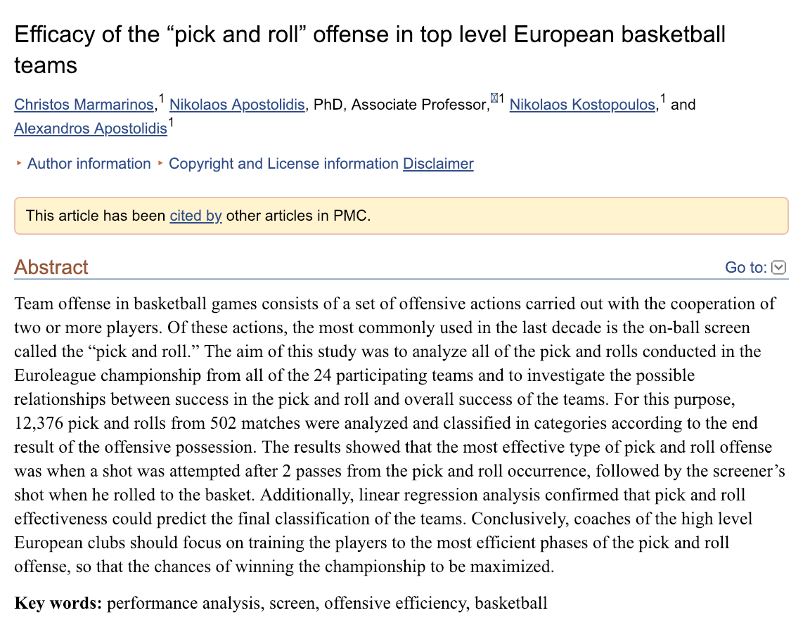
Initial Research
[1]

Slide 3
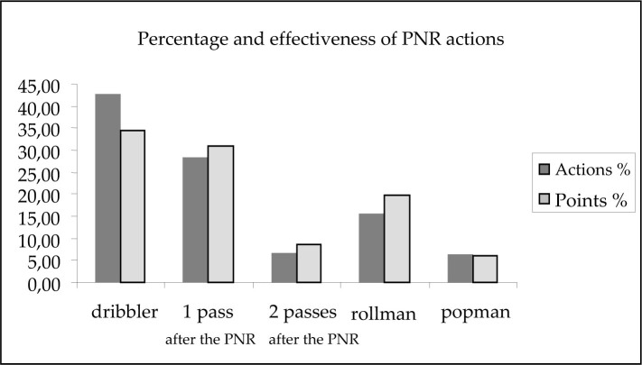
[1]

Slide 4
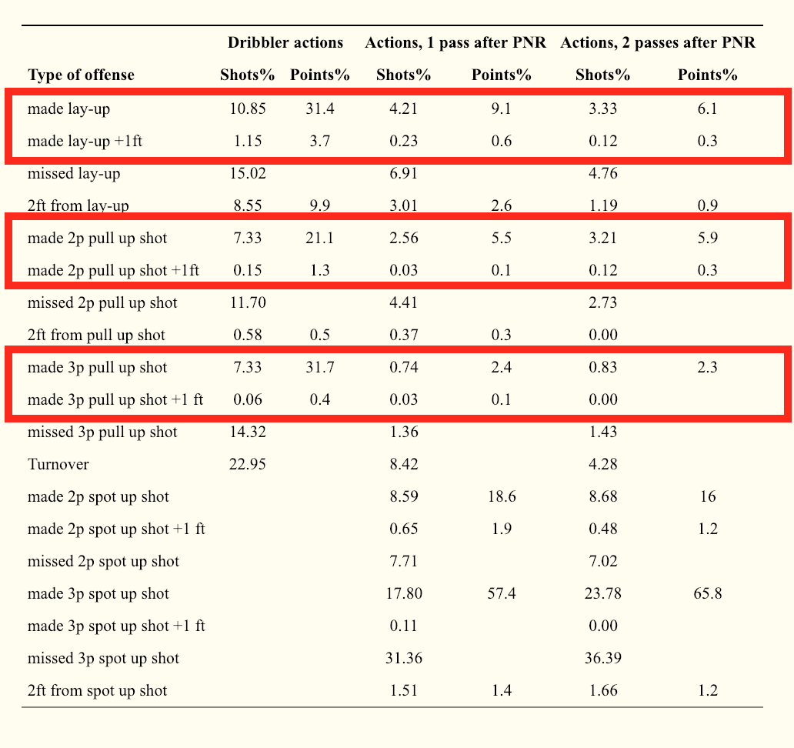
[1]

Slide 5
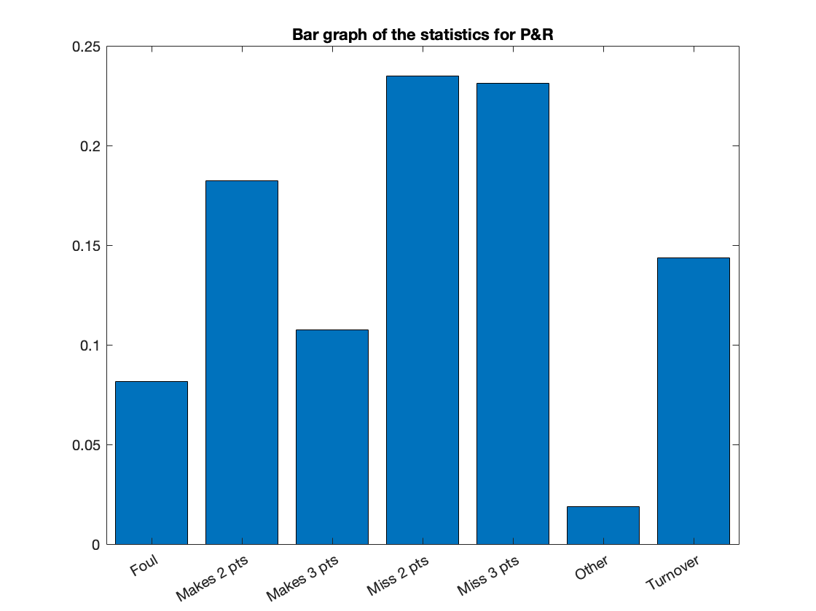
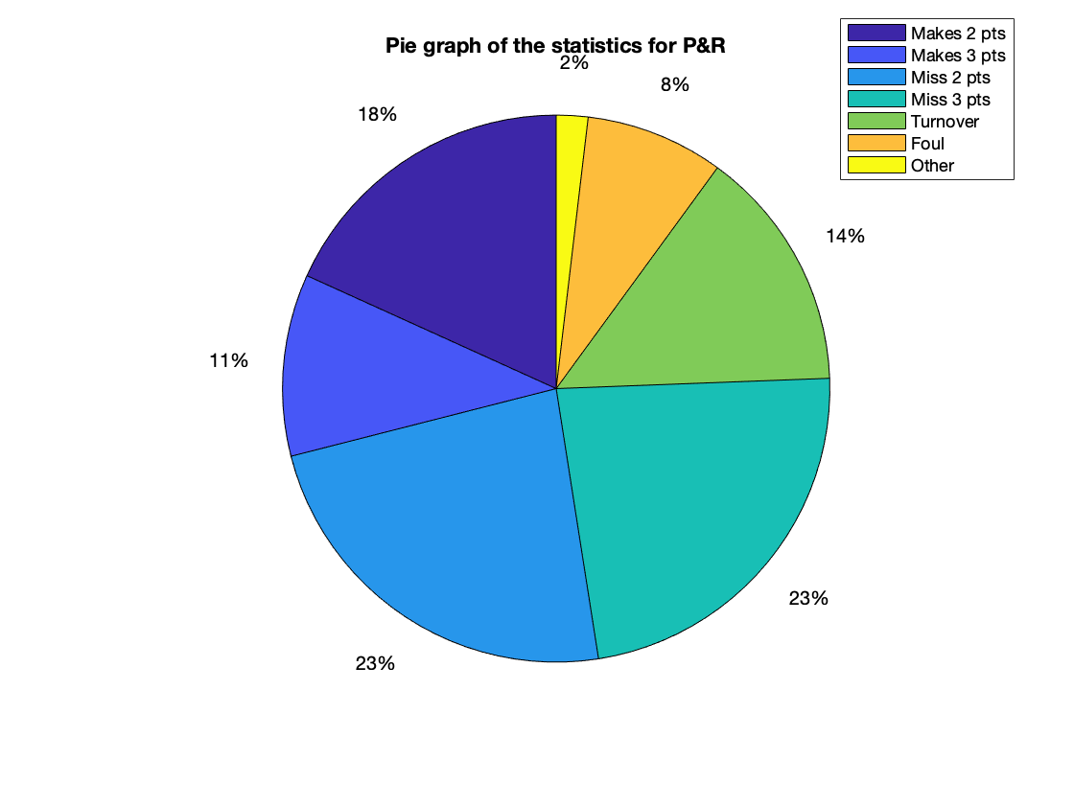
Pick and Rolls

Slide 6

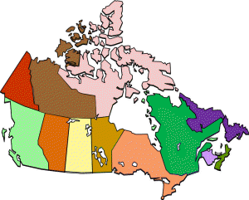
Our Approach:
Determine frequency of each outcome by play type and country.
Compute value of each play from outcome frequency.
‘Hand-off’
‘ISO’
‘Non-possession’
‘Off screen’
‘Offensive Rebound’
‘P&R Ball Handler’
‘Post-Up’
‘Spot-Up’
‘Transition’
‘No Play Type’
‘Foul’
‘Make 2’
‘Make 3’
‘Miss’
‘Turnover’
‘Other’
‘

Slide 7
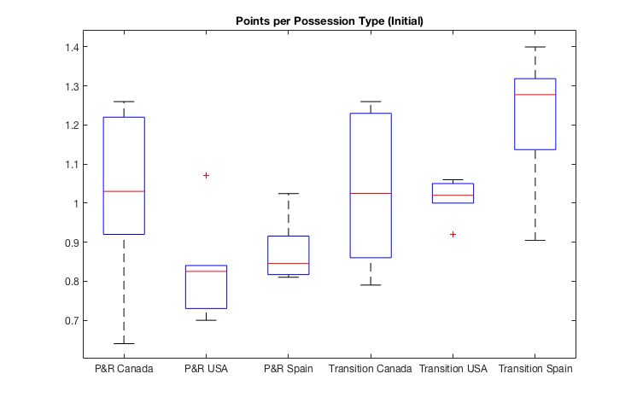
Results
Notes:
Bottom data point for P&R is loss to Venezuela - Traffic problems
On average, we score on P&R and transition well but need to work on consistency (look at USA transition)

Slide 8
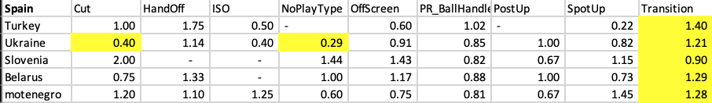
Inferences
BIG TAKEAWAY:
Consistent transitions
TO BEAT THEM:
Loss to Ukraine due to blocked off cuts and plays

Slide 9
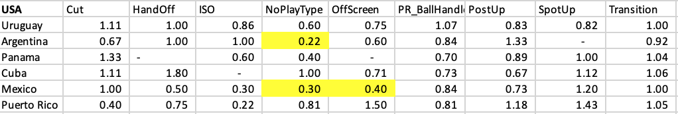
BIG TAKEAWAY:
Power team, everything is high numbers
Flawed in “NoPlayType”
TO BEAT THEM: - Isolate their team and block off their plays and force “NoPlayType”

Slide 10
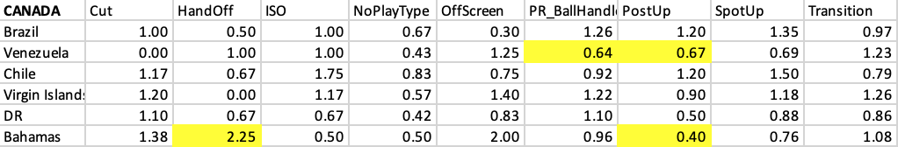
BIG TAKEAWAY:
Inconsistent with points
Strong Pick and Rolls
Bahamas games -> Post up vs Handoff
Bahamas probably had a big team or Canada’s team wasn’t at full strength
Adaptive behavior is required for Canada to be dominant

Slide 11
Future Directions
Determine the value of each play type for individual players.
Incorporate defensive metrics into analysis.
Evaluate play types in more detail.

Slide 12
REFERENCE
[1] https://www.ncbi.nlm.nih.gov/pmc/articles/PMC5260556/

